Slide 1
Replicated File System
A distributed, fault-tolerant application which allows users to safely store files
CDS Project
Pellicci Giacomo
March, 2019

Slide 2
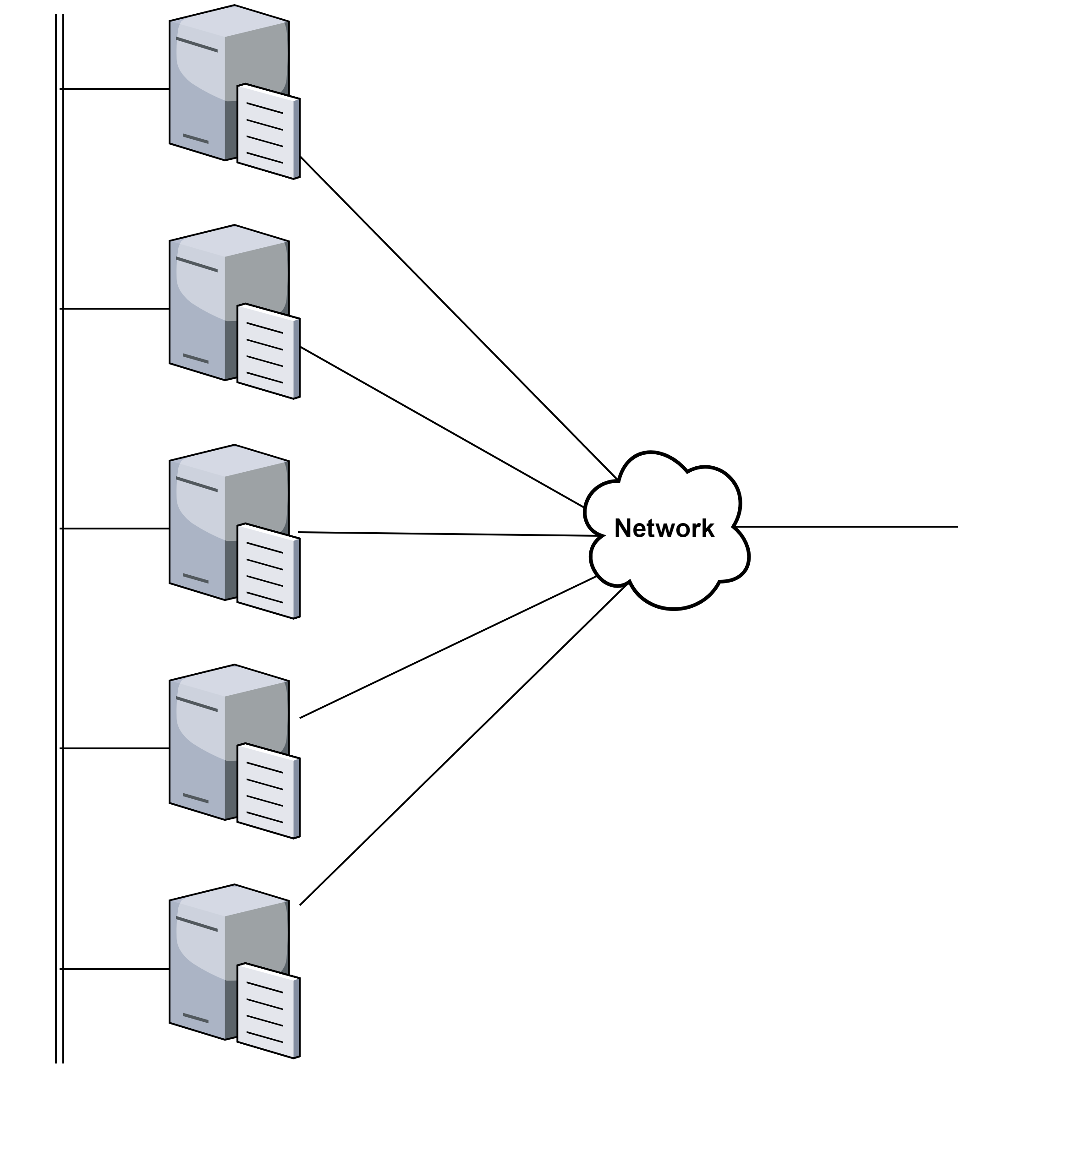
System overview
Cluster of N nodes, tipically 3, 5 or 7
Node consistency is mandatory
A cluster leader must be elected
Only the leader is allowed to perform operation over the file system
Client perceives the cluster as a unique server

Slide 3
Always the same problem: CONSENSUS
Each node has a redundant copy of the whole file system
All those copy must be kept consistent with each other, in particular with the leader one
A distributed consensus algorithm must be used to reach this goal

Slide 4

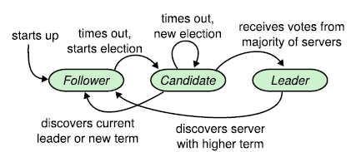
RAFT Consensus algorithm
This algorithm makes N machines reach consensus upon some values, in this case the file system content.
Cluster size of 5 nodes allows the service to remain available when up to 2 nodes are down. Both election and commit processes works if majority of nodes are up and running.
Nodes can be in one of three states:
Leader (unique in each term)
Follower
Candidate

Slide 5
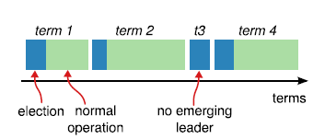
RAFT Leader election
Leader node sends heartbeat to all the follower
If no heartbeat is received within a random timeout, that follower suppose that the leader is down, becomes candidate and begins an election procedure
Time is divided into arbitrary long terms, beginning a new election increase the current term
A candidate asks for votes to the cluster, becomes leader if majority of votes is reached

Slide 6
RAFT Log replication
Client requests: read, write, ls
Read and ls operations can be executed locally by the leader
Write operation must be performed so that the stored file is replicated among the cluster
Raft approach is to send out the command (i.e. store that file) and commit it only if majority of nodes can commit it, abort if not.
To reach this goal files are sent to a temporary directory to followers and moved to permanent directory only when committed, deleted in the other case

Slide 7
Node reboot
Everytime a node is booted (first startup or crash recover), it must synchronize with the leader to guarantee the file system consistency
During this synchronization phase all write operations must be blocked
Leader side semaphore implementation
The synchronization process will involves only different files from the node and the leader, in order to avoid useless file transfer operations

Slide 8
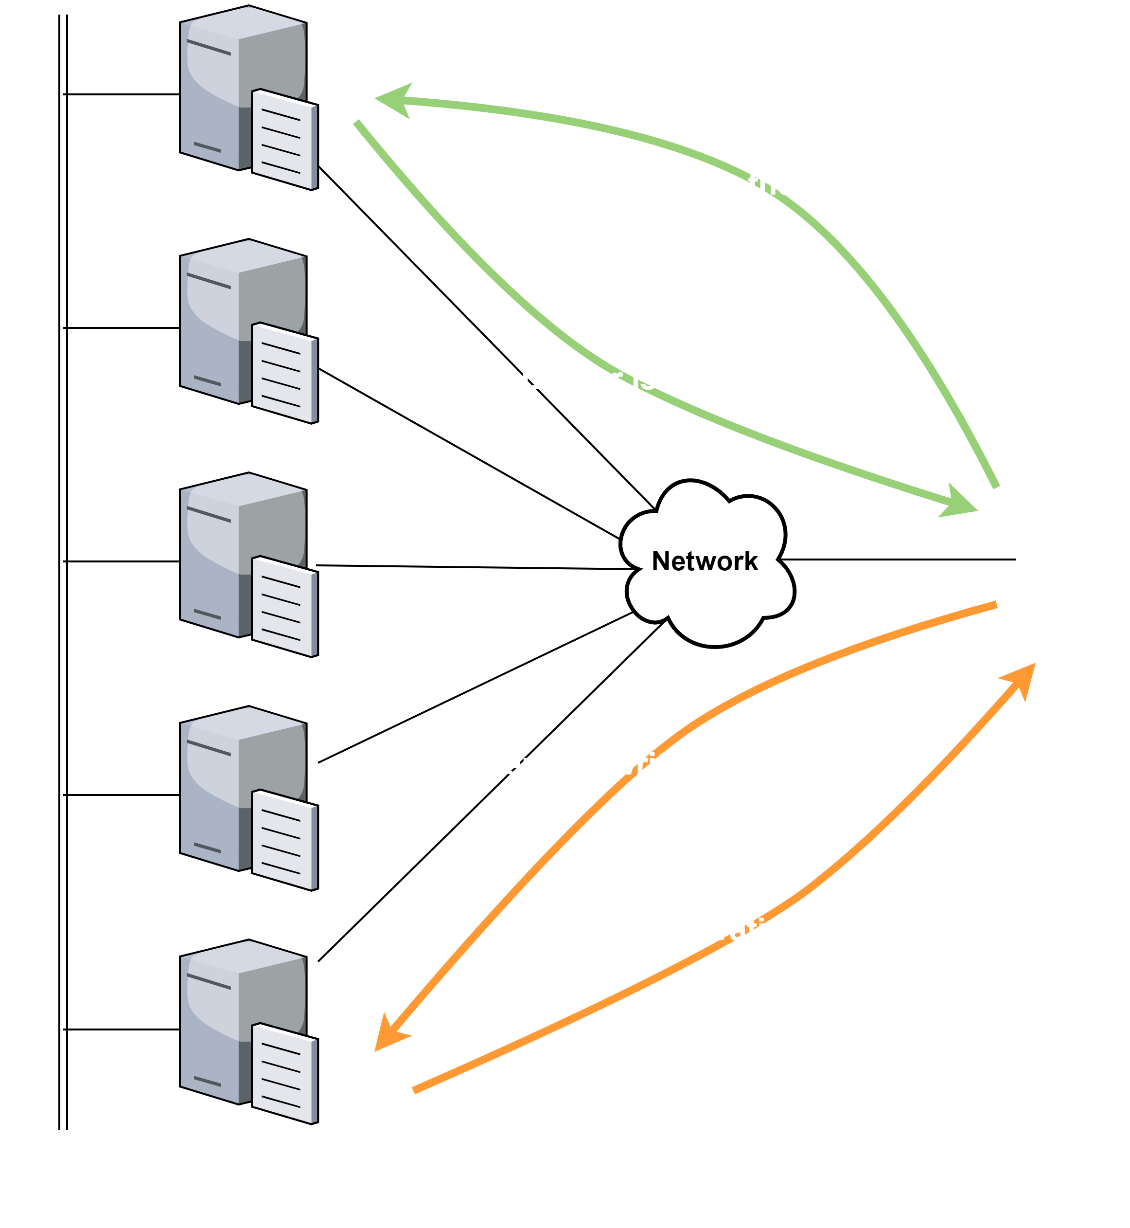
Client behavior
Only the leader node is allowed to perform operation over the file system
The client asks the leader address one after the other to all the nodes
The client will then issue the request (R, W, LS) to the leader
If the leader changed in the meanwhile the client will get an error message

